Slide 1
Smart Home Electrical System
Submitted in the partial fulfillment for the award of the degree of
BACHELOR OF ENGINEERING
IN
INTERNET OF THINGS
Submitted by:
Shinde Smita Shahaji
20BCS4643
Under the Supervision of:
Ms. Shubhangi Mishra Ma’am
Department of AIT-CSE
DISCOVER . LEARN . EMPOWER

Slide 2
Smart Home Electrical System
Creating an IoT-based system to intelligently manage the electricity usage within a smart home environment.

Slide 3
Outline
Introduction to Project
Problem Formulation
Objectives of the work
Hardware System
Software System
Project Scope and Implementation Steps
Methodology Used
Hardware Setup
Schematic Representation PCB Design
Result
Conclusion
References

Slide 4
Introduction to Project
With the rapid advancements in technology, the concept of a "smart home" has become increasingly popular. A smart home leverages Internet of Things (IoT) technology to enhance convenience, comfort, and energy efficiency for homeowners.
Project Significance: The Smart Home Electrical System aims to integrate IoT sensors, smart switches, and software control to create an intelligent ecosystem that adapts to environmental changes and user needs.
Benefits: By combining hardware and software innovations, this project offers the potential to reduce energy consumption, increase home security, and provide a seamless user experience.

Slide 5
Problem Formulation
Energy Waste: Traditional homes often experience energy wastage due to inefficient usage of electrical devices, such as lights and heating/cooling systems.
Manual Control: Users frequently face the inconvenience of manually adjusting devices according to changing conditions, leading to suboptimal energy usage.
User Absence: Devices might be left on when no one is present in the room, contributing to unnecessary energy consumption.
Lack of Adaptability: Conventional homes lack the ability to adapt to changing conditions, leading to discomfort and higher energy bills.
The need for an efficient, user-friendly, and automated home electrical system that can be remotely controlled, optimizes energy consumption, and enhances safety

Slide 6
Objectives of the Work
Develop an integrated system comprising both Hardware (H/W) and Software (S/W) components.
Utilize IoT technology to enhance energy efficiency and user convenience.
Enable real-time monitoring and control of electrical devices through smart switches and sensors.
Enhance home comfort and safety by responding to environmental changes and user presence.

Slide 7
Hardware System
IoT Sensors: Equip each electrical device with IoT-based sensors.
Temperature Sensor: Monitor room temperature for optimal climate control.
Presence Sensor: Detect human presence to automate device activation/deactivation.
Light Sensor: Adjust device behavior based on ambient lighting conditions.
Voice Sensor (Optional): Capture voice commands for advanced control.
Smart Switches: Enable remote control of devices through software interface.
Raspberry Pi Integration: Utilize Raspberry Pi to connect sensors, switches, and centralize control.

Slide 8
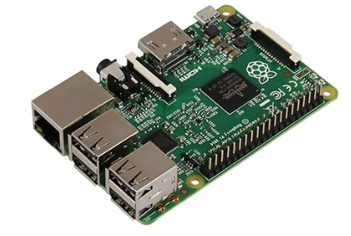
Hardware Specifications
Raspberry Pi :-
The central control unit of the system, Raspberry Pi Module 3, is a versatile single-board computer. It serves as the brain, processing data from sensors and controlling connected devices through its GPIO pins.
Figure 1. Raspberry pi

Slide 9
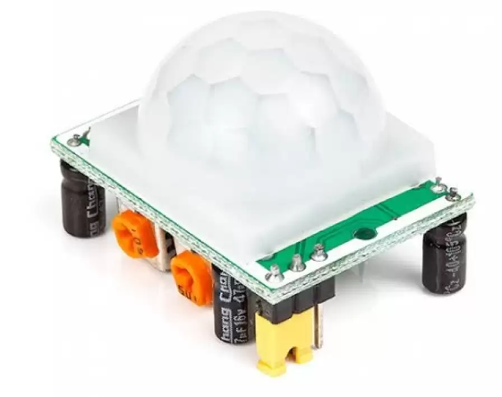
Hardware Specifications
2. PIR Sensor
The Passive Infrared (PIR) sensor detects motion by measuring infrared light radiating from objects in its field of view. In the smart home system, it identifies human presence, triggering automated lighting when someone enters a room.
Figure 2. PIR sensor (Motion sensor)

Slide 10
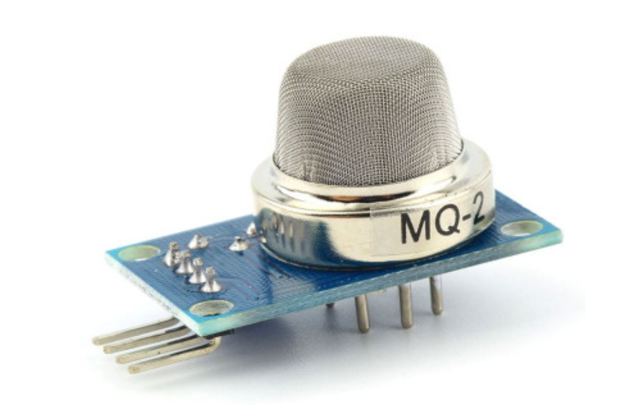
Hardware Specifications
3. MQ2 Sensor
The MQ2 gas sensor is capable of detecting various gases, including methane, propane, and carbon monoxide. It plays a crucial role in the system by identifying gas leaks and ensuring immediate alerts to prevent potential hazards.
Figure 3. MQ2 sensor(Gas sensor)

Slide 11
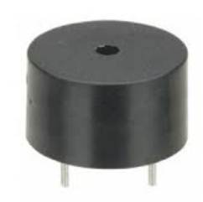
Hardware Specifications
4. Buzzer
The buzzer is an audible signaling device that produces sound when activated. In this system, it serves as an alarm, sounding when the MQ2 sensor detects dangerous gas levels, alerting occupants to the presence of gas leaks.
Figure 4. Buzzer

Slide 12
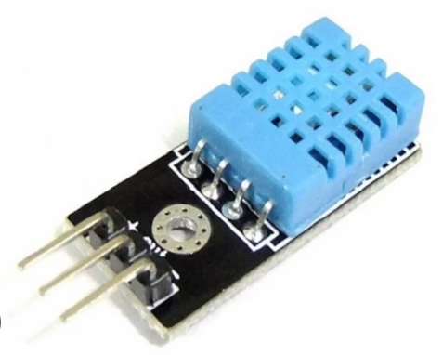
Hardware Specifications
5. DHT11 Sensor
The DHT11 sensor measures temperature and humidity. In the smart home system, it monitors room temperature. When the temperature exceeds a predefined threshold, it triggers the automatic operation of the fan to maintain a comfortable environment.
Figure 5. DHT11 (temperature and humidity sensor)

Slide 13

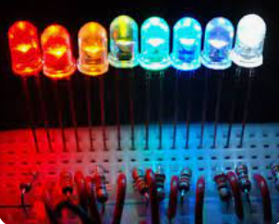
Hardware Specifications
6. LED (Light-Emitting Diode)
The LED is a semiconductor light source that emits light when an electric current passes through it. In this context, LEDs are used as indicator lights, providing visual cues when the system is active or responding to sensor inputs.
Figure 6. Led

Slide 14
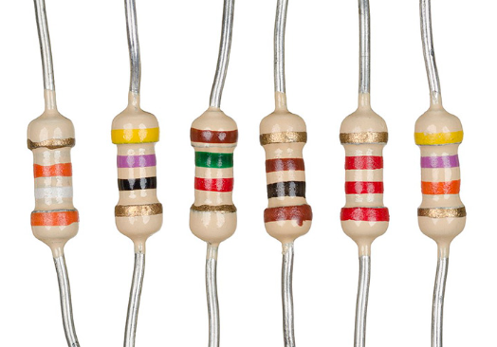
Hardware Specifications
7. Resistor
A resistor is an electronic component that limits or regulates the flow of electric current in a circuit. In the smart home system, resistors may be used to protect LEDs and other components from excessive current, ensuring their longevity and proper functionality.
Figure 7. Resistor

Slide 15
Software System
Centralized Control: Develop software for real-time monitoring and control.
User Interface: Create a user-friendly interface (mobile app/web) for device management.
Automation Rules: Implement logic to automate device behavior based on sensor inputs.
Voice Command Integration (Optional): Develop voice recognition to enable control through voice commands.
Data Analytics: Collect and analyze usage data for insights into energy consumption patterns.

Slide 16
Software System
Centralized Control: Develop software for real-time monitoring and control.
User Interface: Create a user-friendly interface (mobile app/web) for device management.
Automation Rules: Implement logic to automate device behavior based on sensor inputs.
Voice Command Integration (Optional): Develop voice recognition to enable control through voice commands.
Data Analytics: Collect and analyze usage data for insights into energy consumption patterns.

Slide 17

Software Specification
Operating System: The Raspberry Pi is powered by [specify the operating system, e.g., Raspbian], tailored for optimal performance.
Figure 10. Raspbian (OS)

Slide 18

Software Specification
MQTT Dashboard :
Real-time Data Visualization: MQTT Dashboards allow users to visualize real-time data from various sensors and devices. This data can include temperature readings, humidity levels, motion detection status, and other sensor information.
Figure 11. MQTT Dashboard

Slide 19
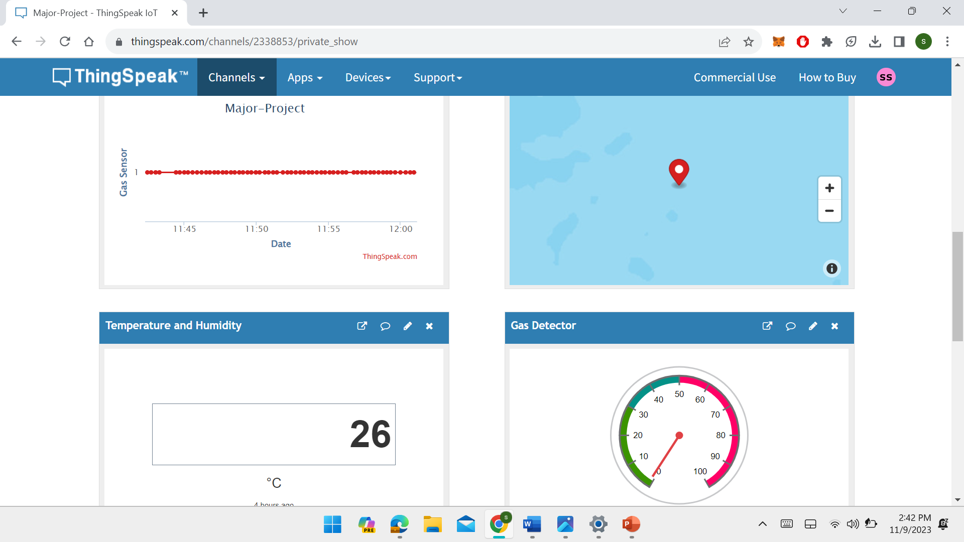
Software Specification
Think Speak : Real-time Data Visualization and it allow users to visualize real-time data from various sensors and devices. This data can include temperature readings, humidity levels, motion detection status, and other sensor information.
Figure 11. Thimkspeak

Slide 20
Project Scope
Scope:
Design and assemble IoT sensors and connect them to electrical devices.
Integrate smart switches and Raspberry Pi for centralized control.
Develop a user interface for remote device management and automation.
Optional: Implement voice command recognition for enhanced user interaction.
Monitor and optimize energy consumption based on usage patterns.

Slide 21
Implementation Steps:
Sensor Integration: Connect temperature, presence, light, and optional voice sensors to devices.
Raspberry Pi Setup: Configure Raspberry Pi to communicate with sensors and switches.
Software Development: Create a software interface for real-time device control and automation.
User Interface Design: Develop a user-friendly app/web interface for remote management.
Automation Logic: Implement rules to automate device behavior based on sensor data.
Optional Voice Integration: If applicable, develop voice command recognition and integration.
Testing and Iteration: Thoroughly test the system, gather feedback, and make improvements.
Deployment: Install the system in a real smart home environment for practical use.

Slide 22
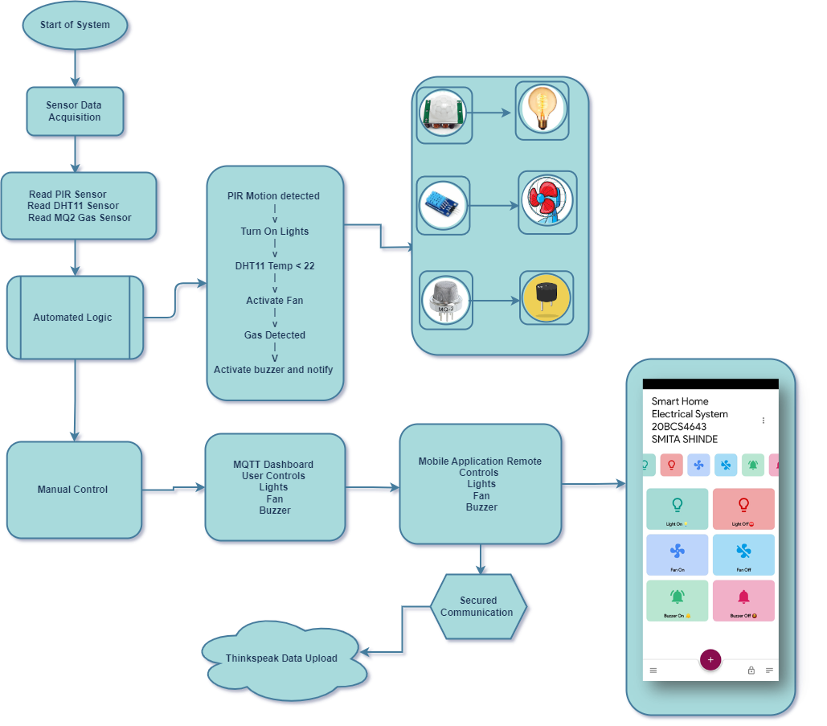
Methodology Used

Slide 23
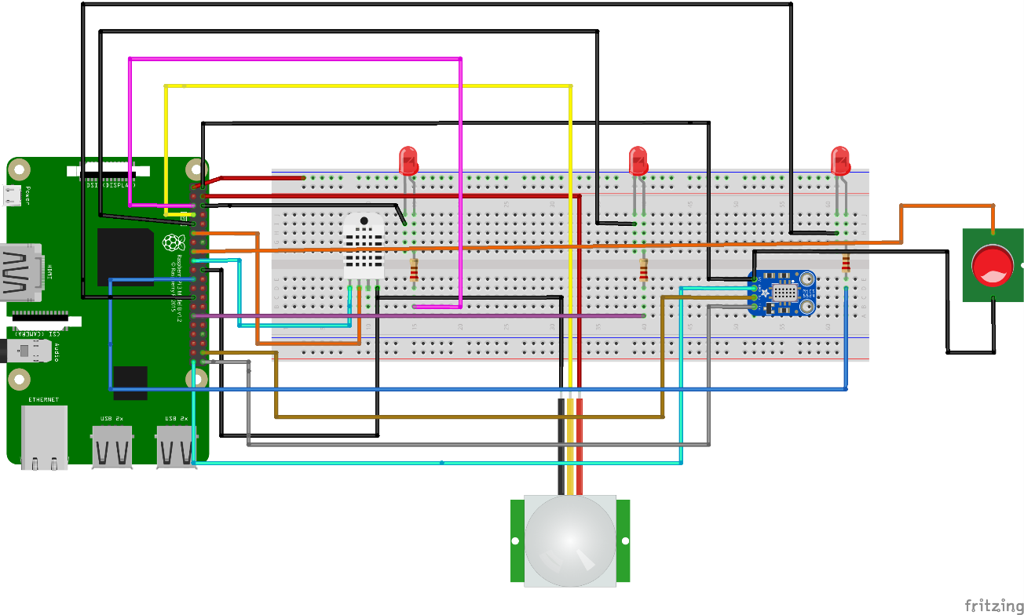
Hardware Setup
Fig. 17. Hardware Design

Slide 24
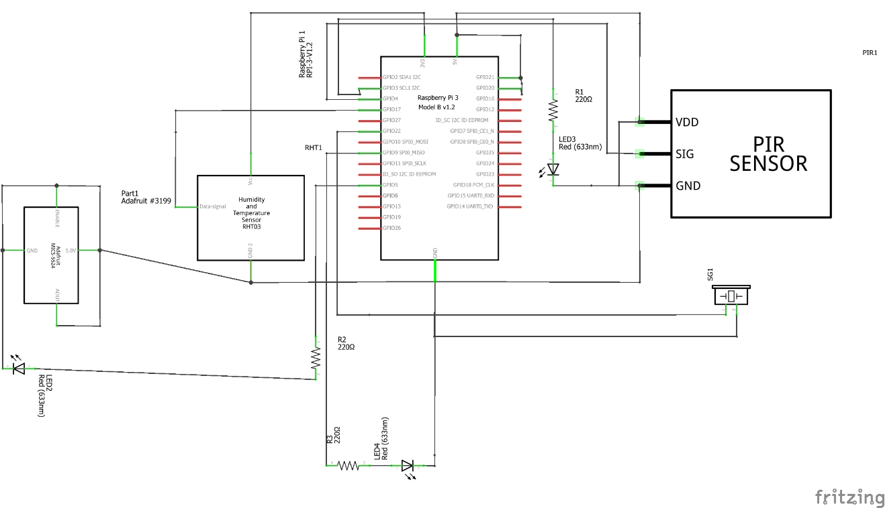
Schematic Representation PCB Design
Fig. 18. PCB Design

Slide 25
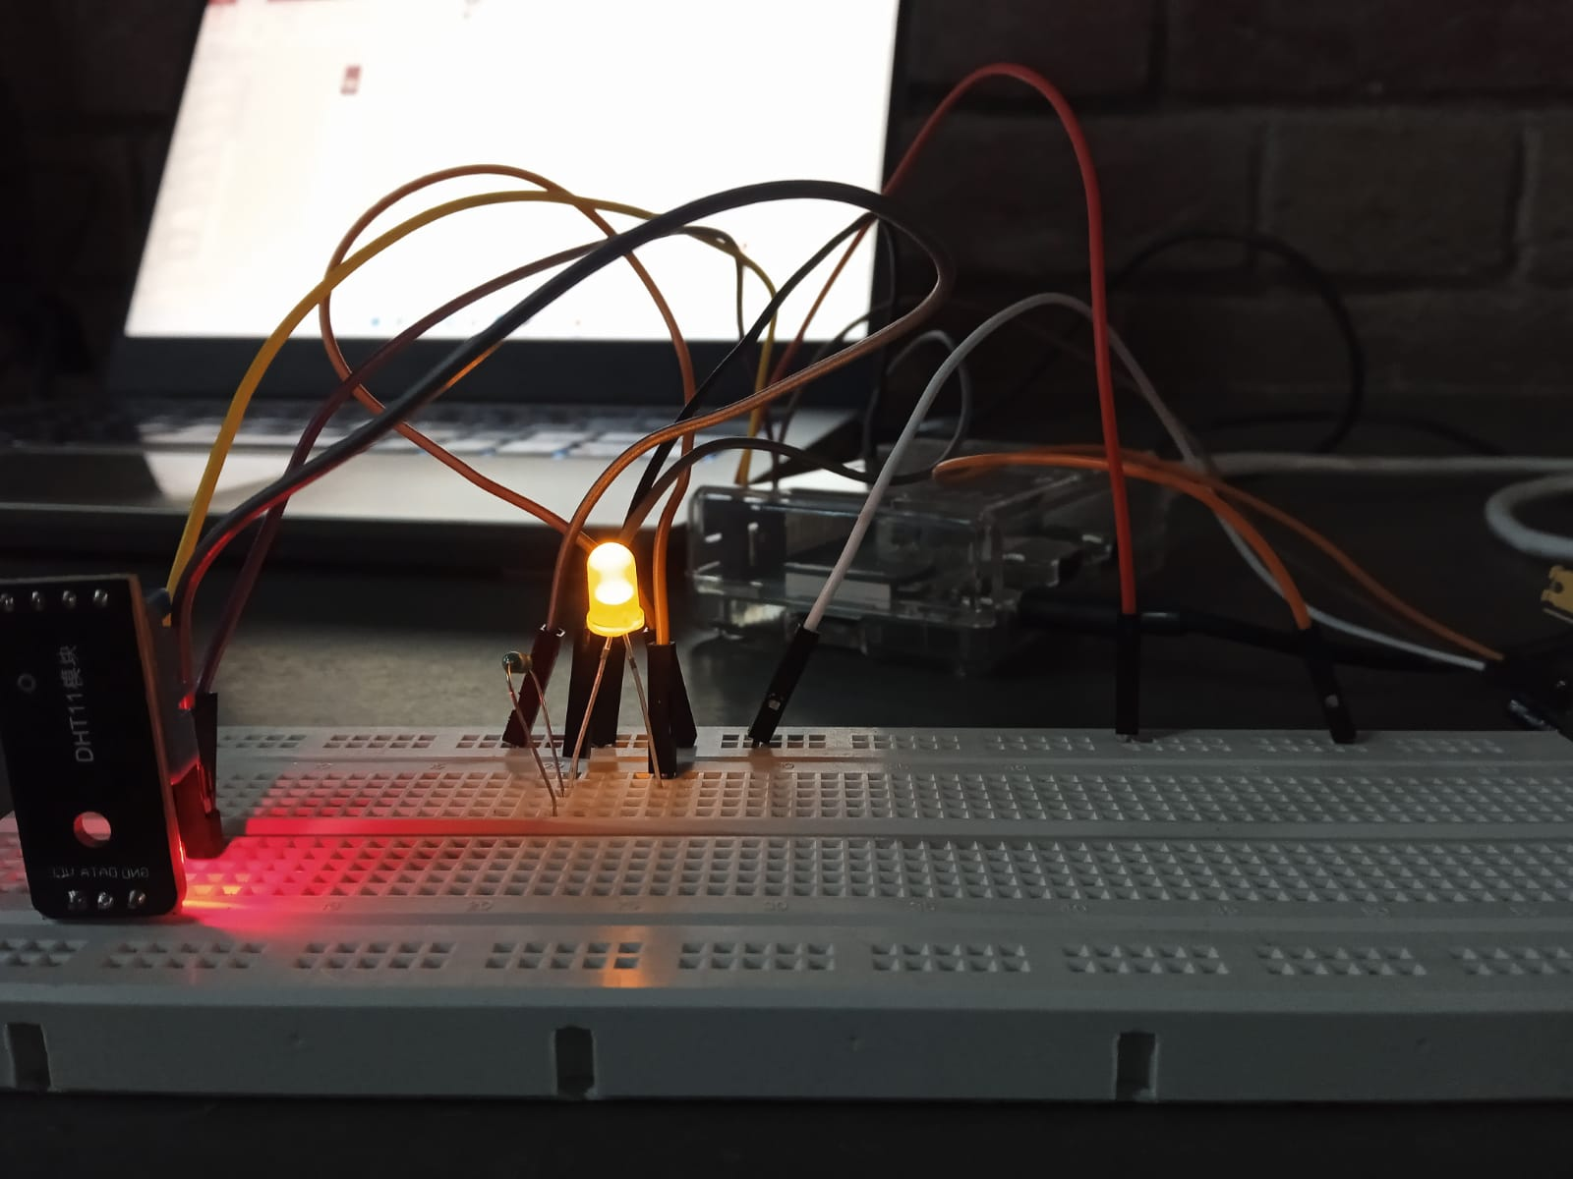
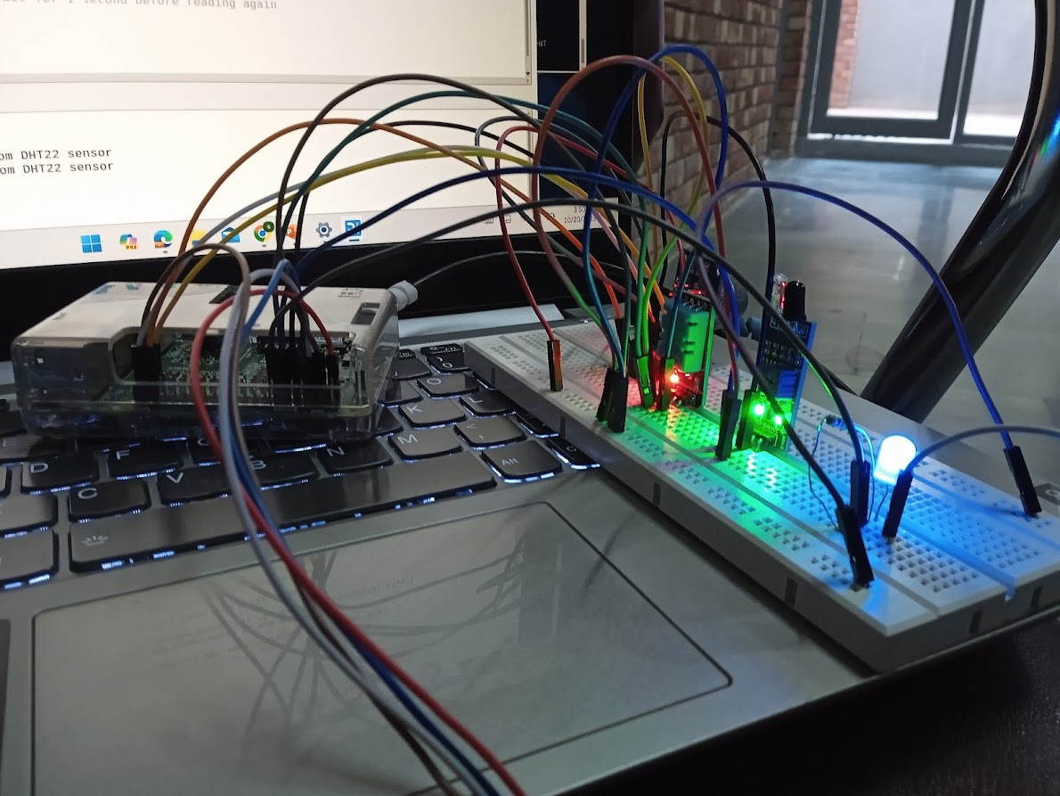
Result

Slide 26
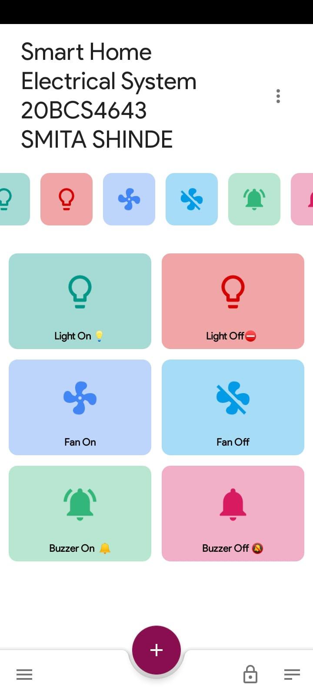
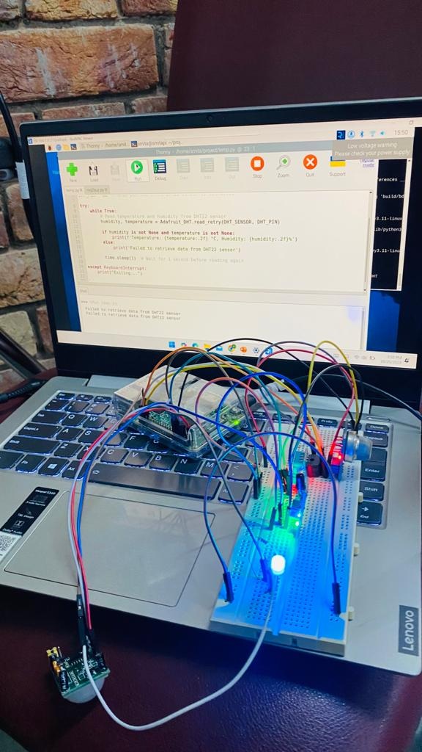
Result

Slide 27
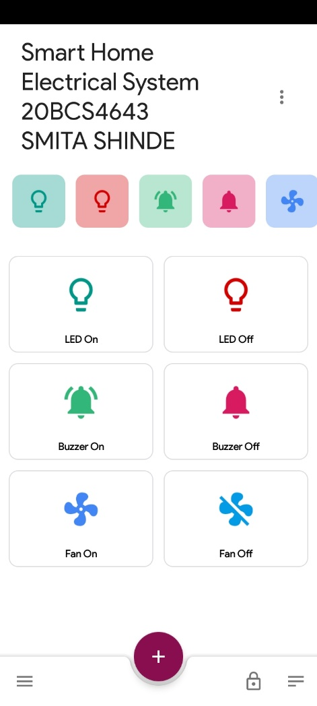
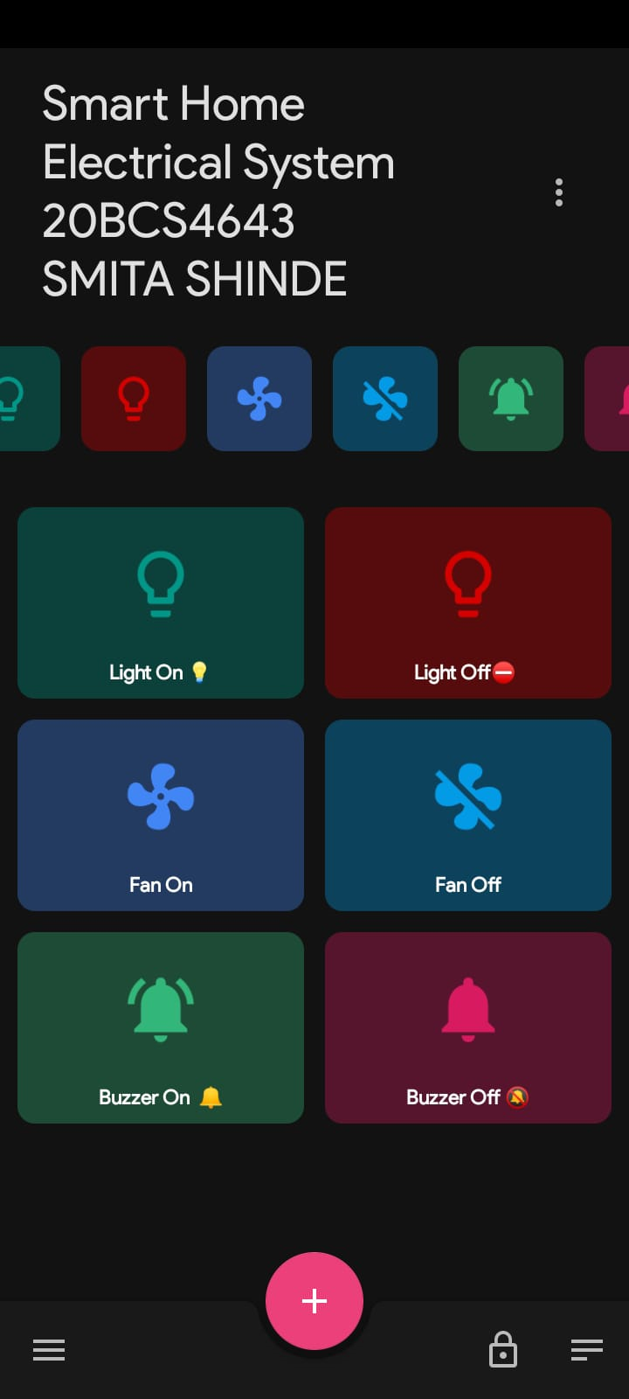
Mobile Application Result

Slide 28
Thinkspeak Data Visualization

Slide 29
Conclusion
The proposed smart home system effectively integrates various sensors and technologies to automate home appliances and enhance safety. The system is flexible, user-friendly, and provides real-time data monitoring, making it a comprehensive solution for a smart home.

Slide 30
References
(1) Smart Home Automation Using IoT and Raspberry Pi - SSRN. https://papers.ssrn.com/sol3/papers.cfm?abstract_id=3568411.
(2) Smart Home Automation Using IoT and Raspberry Pi - SSRN. https://papers.ssrn.com/sol3/papers.cfm?abstract_id=3568411.
(3) IoT based Smart Home Automation System using Raspberry Pi. https://www.ijert.org/research/iot-based-smart-home-automation-system-using-raspberry-pi-IJERTV11IS070165.pdf.
(4) IoT based Smart Home Automation System using Raspberry Pi. https://www.ijert.org/research/iot-based-smart-home-automation-system-using-raspberry-pi-IJERTV11IS070165.pdf.
(5) 50 of the most important Raspberry Pi Sensors and Components. https://tutorials-raspberrypi.com/raspberry-pi-sensors-overview-50-important-components/.
(6) 50 of the most important Raspberry Pi Sensors and Components. https://tutorials-raspberrypi.com/raspberry-pi-sensors-overview-50-important-components/.
(7) IoT-Based Home Automation Using Raspberry Pi | SpringerLink. https://link.springer.com/chapter/10.1007/978-981-16-0669-4_12.
(8) IoT-Based Home Automation Using Raspberry Pi | SpringerLink. https://link.springer.com/chapter/10.1007/978-981-16-0669-4_12.
(9) SMART HOME with Raspberry Pi, ESP32, and ESP8266 - Random Nerd Tutorials. https://randomnerdtutorials.com/smart-home-ebook/.
(10) SMART HOME with Raspberry Pi, ESP32, and ESP8266 - Random Nerd Tutorials. https://randomnerdtutorials.com/smart-home-ebook/.

Slide 31
Thank You

